Slide 1
Trees

Slide 2
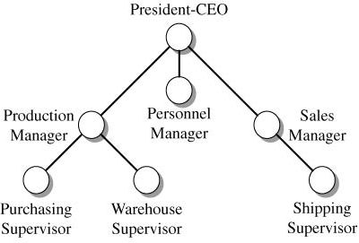
Tree Example

Slide 3
Tree Structures
A tree is a hierarchical structure that places elements in nodes along branches that originate from a root.
Nodes in a tree are subdivided into levels in which the top most level holds the root node.

Slide 4
Trees
Other than the first node or root node, has exactly one parent.
For trees, the operations are dependent upon the type of tree and it’s use.
Any node in a tree can have multiple successors at the next level. Hence, a tree is a nonlinear structure.
Notes:
A Tree is a non-linear structure defined by the concept that each node in the tree, other than the first node or root node, has exactly one parent. After our earlier discussions, one might immediately ask whether a Tree is a data structure or a collection. In general, a tree is a data structure used to implement collections.
Unlike lists where we were able to abstract a set of operations that were common for all lists and then define three specific list collections, it is virtually impossible to define a common set of operations for all trees. For trees, the operations are dependent upon the type of tree and it’s use. Building upon our earlier definitions, a tree can be said to be an abstract data structure because it is a data structure that is not inherently defined within a programming language. Even once we know the specific type and structure of a tree, in most cases, as we will discuss in the next several chapters, a tree is still a data structure used to implement other types of collections. In chapter 17 we will discuss a collection called a hierarchy that is a special kind of tree.

Slide 5
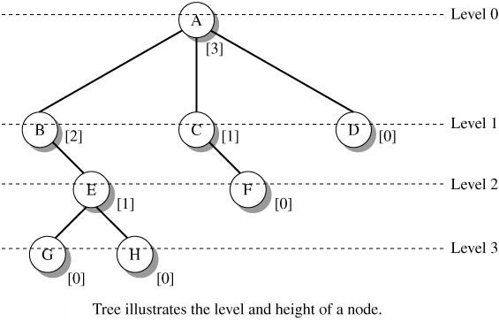
Tree Terminology

Slide 6
Definitions
  node which refers to a location in the tree where an element is stored
  root which refers to the node at the base of the tree or the one node in the tree that does not have a parent
Notes:
In order to discuss trees, we must first have a common vocabulary. We have already introduced a couple of terms: node which refers to a location in the tree where an element is stored, and root which refers to the node at the base of the tree or the one node in the tree that does not have a parent. Trees, in this context, are generally viewed upside down with the root at the top.

Slide 7
Organization chart
president
root node
VP
VP
VP
VP
mgr
mgr
mgr
mgr
leaf nodes

Slide 8
Definitions
Each node of the tree points to the nodes that are directly beneath it in the tree.
These nodes are referred to as its children.
A child of a child is then called a grandchild, a child of a grandchild called a great-grandchild.
A node that does not have children is called a leaf.
A node that is not the root and has at least one child is called an internal node.
Notes:
Each node of the tree points to the nodes that are directly beneath it in the tree. These nodes are referred to as its children. A child of a child is then called a grandchild, a child of a grandchild called a great-grandchild, and so on. A node that does not have children is called a leaf. A node that is not the root and has at least one child is called an internal node.

Slide 9
Definitions
Root Node
Children of A
Internal Node
Leaf Nodes
Notes:
In Figure 10.2, we see that A is the root of the tree, and that B and C are children of A. D is a child of B and a grandchild of A. The list of nodes from A to D, namely A, B, D is called the path from A to D. Nodes D and C are leaves of the tree while node B is an internal node.

Slide 10
Definitions
Any node below another node and on a path from that node is called a descendant of that node.
Any node above another node with a connecting path to that node is called an ancestor of that node.
All children of the same node are called siblings.
Notes:
Any node below another node and on a path from that node is called a descendant of that node. Any node above another node with a connecting path to that node is called an ancestor of that node. All children of the same node are called siblings.

Slide 11
Tree Relationships
Ancestor
Descendents of A and Siblings

Slide 12
Tree Terminology

Slide 13
Definitions
Each node of the tree is at a specific level or depth within the tree.
The level of a node is the length of the path from the root to the node.
This pathlength is determined by counting the number of links that must be followed to get from the root to the node.
Notes:
Each node of the tree is at a specific level or depth within the tree. The level of a node is the length of the path from the root to the node. This pathlength is determined by counting the number of links that must be followed to get from the root to the node. The root is considered to be level 0, the children of the root are at level 1, the grandchildren of the root are at level 2, and so on.

Slide 14
Definitions
The root is considered to be level 0, the children of the root are at level 1, the grandchildren of the root are at level 2, and so on.
The height or order of a tree is the length of the longest path from the root to a leaf.
Notes:
The height or order of a tree is the length of the longest path from the root to a leaf. Thus the height or order of the tree in Figure 10.3 is 3. The path from the root (A) to leaf (F) is of length 3. The path from the root (A) to leaf (C) is of length 1.

Slide 15
Thus the height or order of the tree is 3.
The path from the root (A) to leaf (F) is of length 3.
The path from the root (A) to leaf (C) is of length 1.

Slide 16
Balanced and Unbalanced Trees
A tree is considered to be balanced if all of the leaves of the tree are at roughly the same depth.
Some algorithms define balanced as all of the leaves being at level h or h-1 where h is the height of the tree.
Notes:
The Figure shows two trees. The one on the left is considered balanced while the other is not.

Slide 17
The concept of a complete tree is related to the balance of a tree.
A tree is considered complete if it is balanced and all of the leaves at level h are on the left side of the tree.
Notes:
The concept of a complete tree is related to the balance of a tree. A tree is considered complete if it is balanced and all of the leaves at level h are on the left side of the tree. While a seemingly arbitrary concept, as we will discuss in later chapters, this definition has implications for how the tree is stored in certain implementations.

Slide 18
There are different kinds of trees
– Binary Tree : each node in a binary tree has a
maximum of two children.
– Multiway trees : more general trees, in which
nodes can have more than two children, are
called

Slide 19
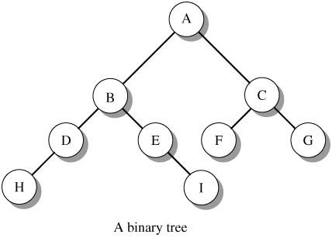
Binary Tree
In a binary tree, each parent has no
more than two children.
A binary tree has a uniform structure that allows a simple description of its node structure and the development of a variety of tree algorithms.

Slide 20
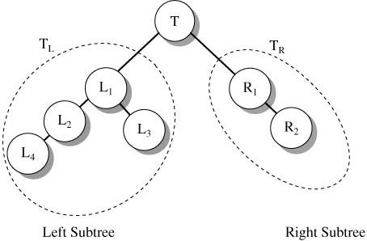
Binary Tree
Each node of a binary tree defines a left and a right subtree. Each subtree is itself a tree.
Right child of T
Left child of T

Slide 21
Binary Tree
Each node has three elements:
  Data (Item Field)
  Left Pointer
  Right Pointer

Slide 22
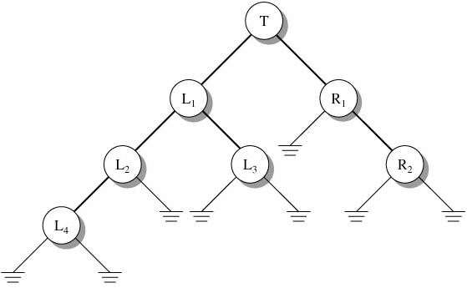
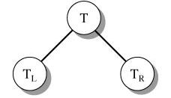
An alternative recursive definition of a binary tree:
  T is a binary tree if T
    has no node (T is an empty tree)
    or
    has at most two sub trees.

Slide 25
General Binary Tree

Slide 26
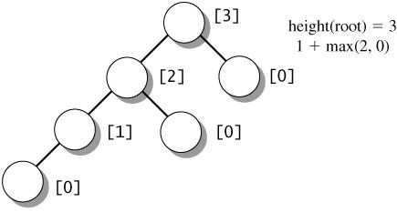
Height of a Binary Tree
The height of a binary tree is the length of the longest path from the root to a leaf node. Let T_{N} be the subtree with root N and T_{L} and T_{R} be the roots of the left and right subtrees of N. Then
{
-1 if T_{N} is empty
1+max( height(T_{L}), height(T_{R})) if T_{N} not empty
height(N) = height(T_{N}) =

Slide 27
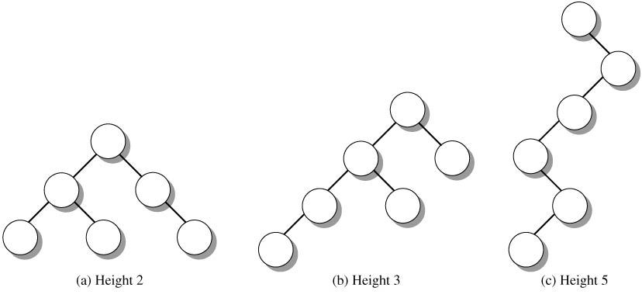
Height of a Binary Tree
Degenerate binary tree

Slide 28
Density of a Binary Tree
In a binary trees, the number of nodes at each level falls within a range of values.
  At level 0, there is 1 node, the root; at level 1 there can be 1 or 2 nodes.
  At any level k, the number of nodes is in the range from 1 to 2^{k}.
  The number of nodes per level contributes to the density of the tree. Intuitively, density is a measure of the size of a tree (number of nodes) relative to the height of the tree.

Slide 29
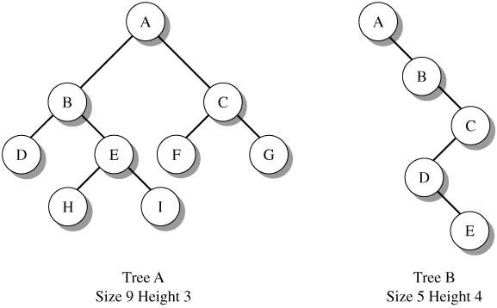
Density of a Binary Tree

Slide 30
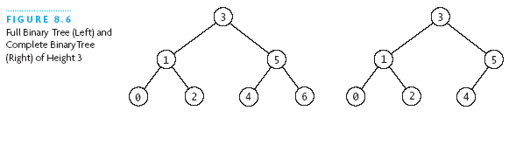
Fullness and Completeness
A binary tree is full if all leaves are at the same level
In a full tree, every node has 0 or 2 non-null children.
A binary tree is complete if:
  All leaves are at level h or level h-1 (for some h)
  All level h-1 leaves are to the right
Full Binary Tree
Complete Binary Tree

Slide 31
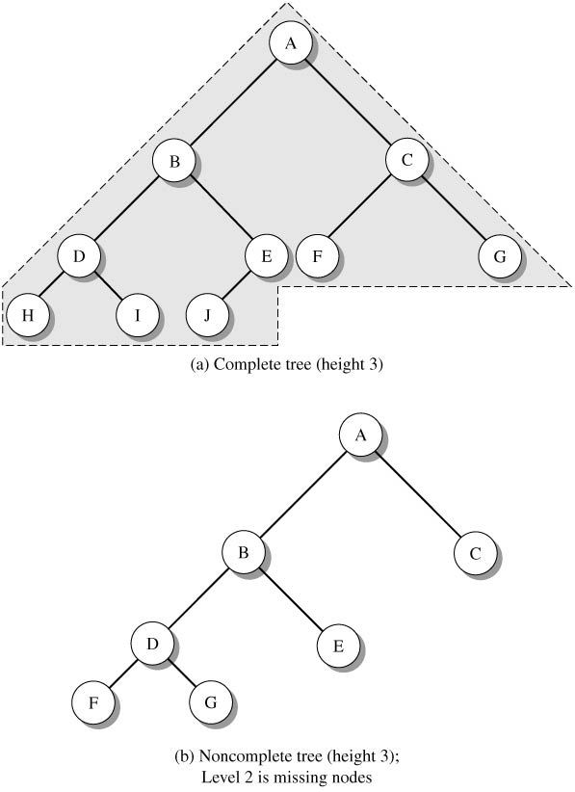

Slide 32
Binary Search Tree
BST contains Comparable objects (or a comparator is supplied).
For each node, all the values in its left subtree are smaller than the value in the node and all the values in its right subtree are larger than the value in the node.
a BST
not a BST
15
/ \
8 20
/ \
1 12
15
/ \
12 20
/ \
1 8
Notes:
Thus every subtree in a BST is a BST.

Slide 33
Binary Search Tree
Binary search trees allow for fast insertion and removal of elements.
They are specially designed for fast searching.
All nodes in a binary search tree fulfill the property that:
  Descendants to the left have smaller data values than the node data value
  Descendants to the right have larger data values than the node data value

Slide 34
Building a Binary Search Tree
Insertion strategy:
  If the value of the new element is equal to the value of the current node, perform no action.
  If the value of the new element is less than the value of the current node, proceed to the left subtree (left child) of the node. If null, insert the node as a left child of the parent.
  If the value of the new element is greater than the value of the current node, proceed to the right subtree (right child) of the node. If null, insert the node as a left child of the parent.

Slide 35
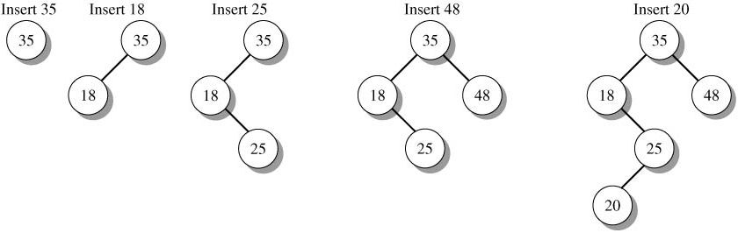
Building a Binary Search Tree

Slide 36
Example
Insert the following into a binary search tree:
50, 34, 12, 78, 36, 30, 67, 44, 52
Insert the following into a binary search tree:
N, A, Y, T, F, D, S, R, R

Slide 37
Implementation of a Binary Tree
To create a node in a binary tree:
We need a class of node objects.
These objects contain the data representing
the objects being stored and also references to each of the node's two children.

Slide 38
class Node
{
int iData; // data used as key value
float fData; // other data
node leftChild; // this node's left child
node rightChild; // this node's right child

Slide 39
The Tree Class
– We'll also need a class from which to instantiate the tree itself; the object that holds all the nodes.
– We'll call this class Tree. It has only one field: a Node variable that holds the root.

Slide 40
– It doesn't need fields for the other nodes because they are all accessed from the root.
– The Tree class has a number of methods: some for finding, inserting, and deleting nodes, several for different kinds of traverses, and one to display the tree.

Slide 41
class Tree
{ private Node root; // the only data field in Tree
public void find(int key)
{ }
public void insert(int id, double dd)
{ }
public void delete(int id)
{ }
// various other methods
} // end class Tree

Slide 42
Inserting a Node
To insert a node:
We follow the path from the root to the appropriate node, which will be the parent of the new node.
Once this parent is found, the new node is connected as its left or right child, depending on whether the new node's key is less than or greater than that of the parent.

Slide 43
Java Implementation
public void insert(int id, double dd)
{
// make new node
Node newNode = new Node();
newNode.iData = id; // insert data
newNode.fData = dd;

Slide 44
if(root==null) // no node in root
root = newNode;
else // root occupied
{
Node current = root; // start at root
Node parent;
while(true) // (exits internally)
{
parent = current;

Slide 45
if(id < current.iData) // go left?
{
current = current.leftChild;
if(current == null) // if end of the line,
{ // insert on left
parent.leftChild = newNode;
return;
}
} // end if go left

Slide 46
else // or go right
{
current = current.rightChild;
if(current == null) // if end of the line
{ // insert on right
parent.rightChild = newNode;
return;
}
}}}
} // end insert()

Slide 47
Searching a Binary Tree
Here's the code for the find() routine, which is method of the Tree class:
// find node with given key
public Node find(int key)
{ // (assumes non-empty tree)
Node current = root; // start at root

Slide 48
while(current.iData != key) // while no match
{
if(key < current.iData) // go left?
current = current.leftChild;
else
current = current.rightChild; // or go right?
if(current == null) // if no child,
return null; // didn't find it
}
return current; } // found it

Slide 49
class TreeApp
{
public static void main(String[] args)
{
Tree theTree = new Tree; // make a tree
// insert 3 nodes
theTree.insert(50, 1.5);
theTree.insert(25, 1.7);
theTree.insert(75, 1.9);

Slide 50
// find node with key 25
Node found = theTree.find(25);
if(found != null)
System.out.println("Found the node with key 25");
else
System.out.println("Cannot find node with key 25");
} // end main()
} // end class TreeApp

Slide 51
Ways of traversing a Tree
Tree-traversal refers to the process of visiting each node in a tree data structure, exactly once, in a systematic way.
Item insertion, deletion, and lookup operations require that the binary tree be traversed.
Such traversals are classified by the order in
which the nodes are visited.

Slide 52
Traversals
Preorder: first process the root, then traverse the left and right sub trees,
A
/ \
B C
/ \
D E
1. Visit the node.
2. Traverse the left subtree.
3. Traverse the right subtree.
(This is also called Depth-first traversal.)
A B D E C
Notes:
Preorder traversal makes sense, for example, for finding a given value in the tree.

Slide 53
Traversals
Postorder: first traverse the left and right sub trees, then process the root.
A
/ \
B C
/ \
D E
1. Traverse the left subtree.
2. Traverse the right subtree.
3. Visit the node.
D E B C A
Notes:
Postorder traversal would make sense for finding a leaf with a given property.

Slide 54
Traversals
Inorder: first traverse the left sub tree, then process the root, then traverse the right sub tree.
A
/ \
B C
/ \
D E
1. Traverse the left sub tree.
2. Visit the node.
3. Traverse the right sub tree.
D B E A C
Notes:
Inorder traversal visits the nodes in a binary search tree (next slide) in ascending order. It can also be used to restore an expression from its expression tree.

Slide 55
Traversals
Trees can also be traversed in level-order, where we visit every node on a level before going to a lower level.
This is also called Breadth-first traversal.

Slide 56
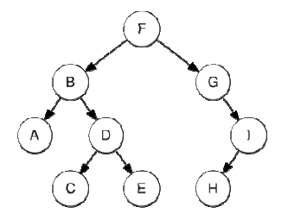

Slide 57
Preorder traversal sequence:
F, B, A, D, C, E, G, I, H
Inorder traversal sequence:
A, B, C, D, E, F, G, H, I
Postorder traversal sequence:
A, C, E, D, B, H, I, G, F
Level-order traversal sequence:
F, B, G, A, D, I, C, E, H

Slide 58
Traversals
1
Preorder: root ⎯ left ⎯ right
Inorder: left ⎯ root ⎯ right
Postorder: left ⎯ right ⎯ root
2
3
2
1
3
3
1
2
Notes:
Each type of traversal has its own applications. You can also traverse root - right - left, etc.

Slide 59
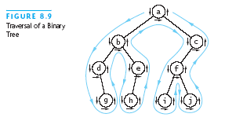
Preorder
Preorder:
a, b, d, g, e,
h, c, f, i, j

Slide 60
Inorder
Inorder:
d, g, b, h, e,
a, i, f, j, c

Slide 61
Postorder
Postorder:
g, d, h, e, b,
i, j, f, c, a

Slide 62
Breadth-first search (BFS)
Breadth-first search (BFS) is a graph search algorithm that begins at the root node and explores all the neighboring nodes. Then for each of those nearest nodes, it explores their unexplored neighbor nodes, and so on, until it finds the goal.

Slide 63
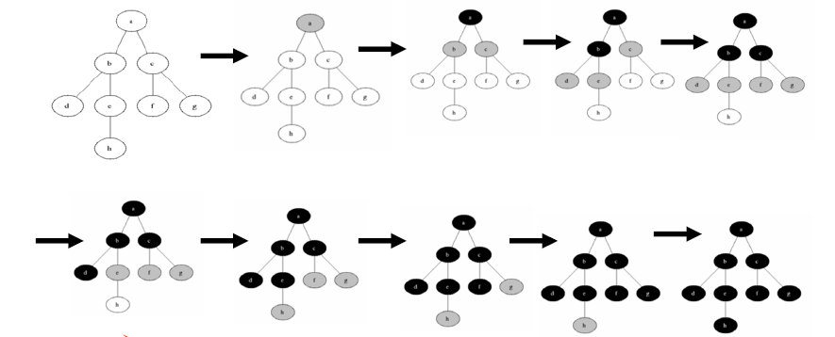

Slide 64
Applications of BFS
Breadth-first search can be used to solve many
problems in graph theory, for example:
– Finding all connected components in a graph.
– Finding all nodes within one connected component.
– Copying Collection, Cheney's algorithm.
– Finding the shortest path between two nodes u and v(in an unweighted graph).
– Testing a graph for bipartitions.

Slide 65
Depth-first search (DFS)
Depth-first search (DFS) is an algorithm for traversing or searching a tree, tree structure, or graph.
One starts at the root (selecting some node as the root in the graph case) and explores as far as possible along each branch before backtracking.

Slide 66
Deleting a Node of a BST
The algorithm to delete an arbitrary node from a binary search tree is deceptively complex, as there are many special cases.
The algorithm used for the delete function splits it into two separate operations, searching and deletion.

Slide 67
Once the node which is to be deleted has been determined by the searching algorithm, it can be deleted from the tree.
The algorithm must ensure that when the node is deleted from the tree, the ordering of the binary tree is kept intact.

Slide 68
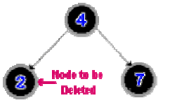
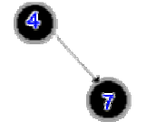
Case 1
The node to be deleted has no children.
Before Deletion
After Deletion

Slide 69
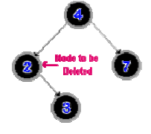
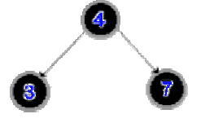
Case 2
The node has one child.
Before Deletion
After Deletion

Slide 70
Case 3
The node to be deleted has two children.
This case is much more complex than the previous two, because the order of the binary tree must be kept intact.
The algorithm must determine which node to use in place of the node to be deleted.

Slide 71
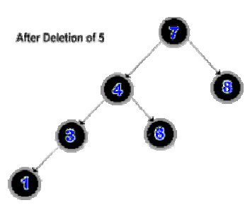
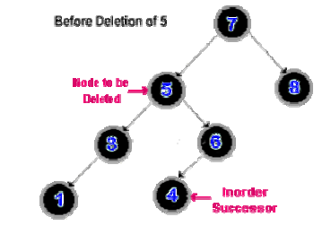
(i)Use the inorder successor of the node to
be deleted.

Slide 72
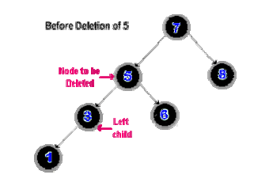
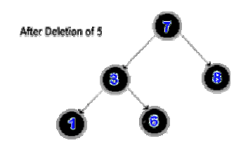
(ii) If no right sub tree exists replace the
node to be deleted with it's left child.

Slide 73
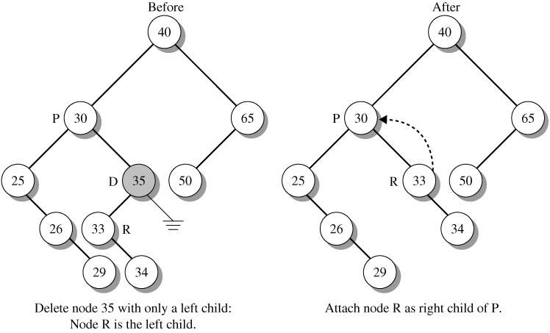
Case 4
Deleted Node has an Empty Subtree

Slide 74
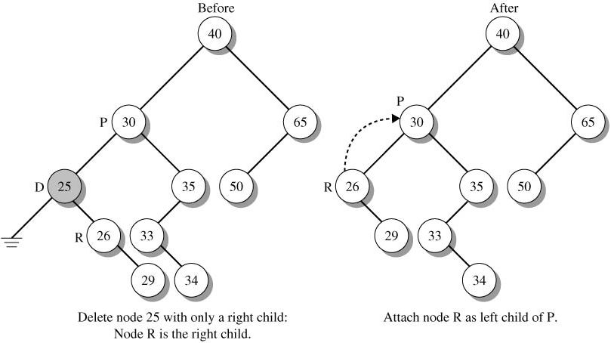

Slide 75
Removing the Root Node
Step 1:
Find the smallest node of the right subtree
Step 2:
Unlink that node and promote its right child into its place
50
50
30
75
60
30
75
25
40
60
90
25
40
70
90
20
70
20
69
72
69
72
50
Step 3:
Link that note in place of the root and remove the old root
60
30
75
25
40
70
90
20
69
72
Notes:
The smallest node of the right subtree has at most one child.
This algorithm applies to the root of any subtree in a BST. To remove any node from a BST, consider its subtree rooted at that node, apply the above procedure to that subtree, then link the new root to the parent of the original node.

Slide 76
Expression Trees
Store expressions in a binary tree
  Leaves of tree are operands (constants, variables)
  Other internal nodes are unary or binary operations
Used by compilers to parse and evaluate expressions
  Arithmetic, logic, etc.

Slide 77
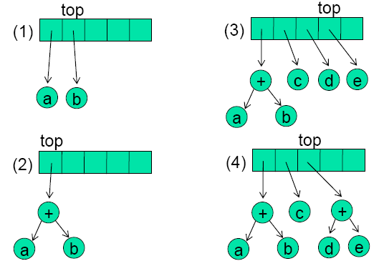
Expression Trees
Constructing expression tree: Input: ab + cde+**
Stack grow from left to right

Slide 78
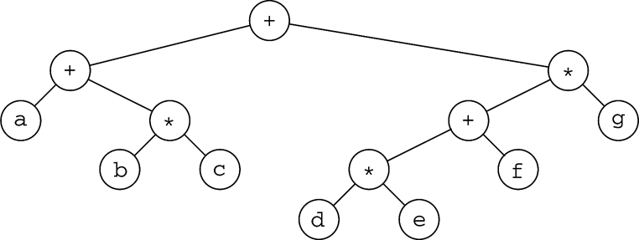
Expression Trees
Constructing an expression tree from postfix notation
  Use a stack of pointers to trees
  Read postfix expression left to right
  If operand, then push on stack
  If operator, then:
    Create a BinaryTreeNode with operator as the element
    Pop top two items off stack
    Insert these items as left and right child of new node
    Push pointer to node on the stack
(a+b*c) + ((d*e+f)*g)

Slide 79
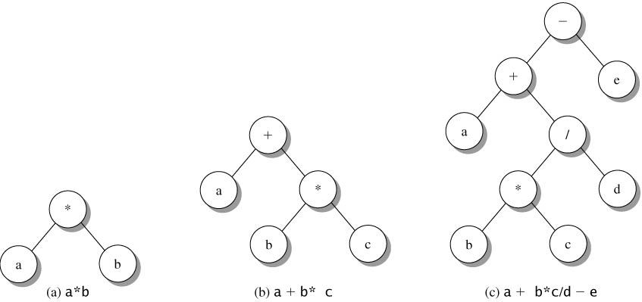
Expression Trees
A binary expression tree represents an arithmetic expression.
  In an expression tree each operator is an interior node whose children are operands or sub expressions. Operands are in leaf nodes.

Slide 80
Expression Trees
The preorder and postorder traversals of a binary expression tree produce the prefix and postfix (RPN) notation for the expression.
An inorder traversal generates the infix form of the expression, assuming that parentheses are not needed to determine the order of evaluation

Slide 81
Expression Trees
Preorder(Prefix): - + a / * b c d e
Inorder(Infix): a + b * c / d – e
Postorder(Postfix): a b c * d / + e -

Slide 82
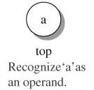
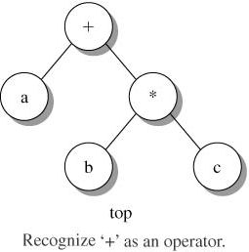
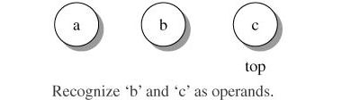
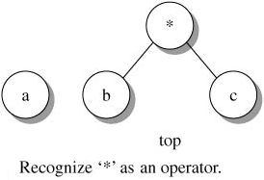
Building a Binary Expression Tree
a b c * +

Slide 83
Balancing a Tree
BSTs where introduced because in theory they give nice fast search time.
But it is not always hold. It all depends on what the tree looks like.

Slide 84
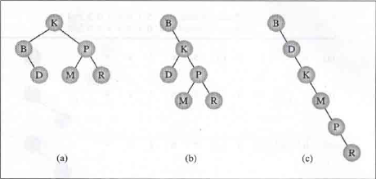
Even though every tree install the same data the tree in figure (a) is best and tree in figure (c) is worst.
In this kind of situation it’s better to balance a tree to have the best solution.

Slide 85
Balancing a tree -ideas
One idea would be to get all of the data first, and store it in an array.
Then sort the array and then insert it in a tree.
This algorithm has serious drawback, where all the data should be entered in to an array before the tree can be created.

Slide 86
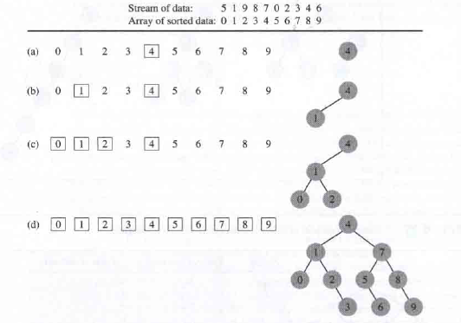

Slide 87
The previous algorithm is inefficient since it is required an additional array to which data needed to be sorted.
To avoid sorting, it required deconstructing and then reconstructing the tree, which is again some what inefficient.

Slide 88
DSW Algorithm
To overcome this we use an algorithm that requires additional storage for intermediate variables and use no sorting procedure.
That is DSW Algorithm Named for Colin Day and then for Quentin F. Stout and Bette L. Warren, hence DSW.
(Day/Stout/Warren Algorithm)

Slide 89
The building block for tree transformation in DSW algorithm is the rotation.
This is a method for efficiently balancing binary search trees — that is, decreasing their height.
There are two type of rotations, left and right, which are symmetrical to one another.

Slide 90
Rotations change the structure of a binary tree.
In particular, rotations can often, depending on the tree’s shape, be used to change the height of a part of a binary tree.
Rotations change the local structure of a binary tree. Any given rotation only affects the node rotated and its immediate children.
The node’s ancestors and its children’s children are unchanged.

Slide 91
Rotations do not change the ordering of a binary tree.
If a binary tree is a binary search tree before a rotation, it is a binary search tree after a rotation. So, we can safely use rotations to rearrange a BST-based structure, without concerns about upsetting its ordering.

Slide 92
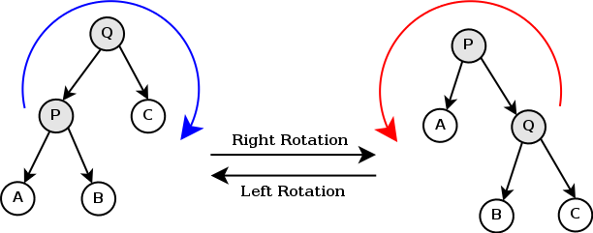

Slide 93
So the idea is to take a tree and perform some rotations to it to make it balanced.
First you create a backbone or a vine
Then you transform the backbone into a nicely balanced tree

Slide 94
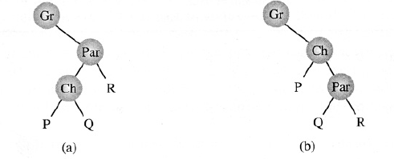
rotateRight( Gr, Par, Ch )
– If Par is not the root of the tree
Grandparent Gr of child Ch, becomes Ch’s parent by replacing Par;
– Right subtree of Ch becomes left subtree of Ch’s
parent Par;
– Node Ch aquires Par as its right child

Slide 95
Algorithm
createBackbone(root, n )
– Tmp = root
– While ( Tmp != 0 )
• If Tmp has a left child
– Rotate this child about Tmp
– Set Tmp to the child which just became parent
• Else set Tmp to its right child

Slide 96
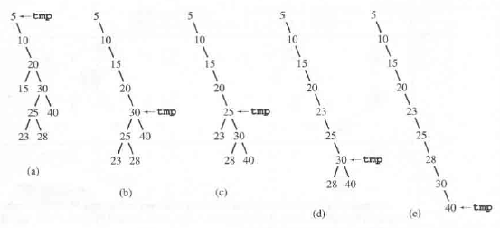

Slide 97
createPerfectTree(n)
M = 2floor[lg(n+1)]-1;
Make n-M rotations starting from the top of the backbone;
While ( M > 1 )
{ M = M/2;
Make M rotations starting from the top of the backbone; }

Slide 98
The DSW algorithm is good if we can take the time to get all the nodes and then create the tree.
If we want to balance the tree as we move, use an AVL Tree.

Slide 99
AVL Trees
Named after its inventors Adel’son-Vel’skii and Landis, hence AVL.
The heights of any subtree can only differ by at most one.
Each nodes will indicate balance factors.
Worst case for an AVL tree is 44% worst then a perfect tree.
In practice, it is closer to a perfect tree.

Slide 100
AVL Trees
AVL tree: A binary search tree where
  Heights of left and right subtrees differs by at most 1
  Left and right subtrees are AVL trees
Balance factor
  Difference between height of right subtree and height of left subtree

Slide 101
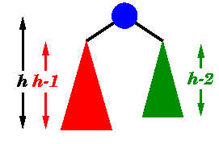
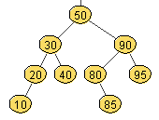
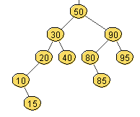
an AVL tree is a binary search tree where
  for every node, the heights of the left and right subtrees differ by at most 1
  first self-balancing binary search tree variant
  named after Adelson-Velskii & Landis (1962)
AVL tree
not an AVL tree

Slide 102
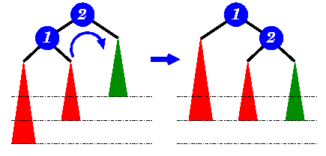
Inserting/removing from AVL tree
when you insert or remove from an AVL tree,
may need to rebalance
  add/remove value as with binary search trees
  may need to rotate subtrees to rebalance
worst case, inserting/removing requires traversing the path back to the root and rotating at each level

Slide 103
Insertion into AVL Trees
General steps
  Search AVL tree to find insertion point
  Insert new item
    Duplicate items are not allowed
  Rebalance tree (if needed)

Slide 104
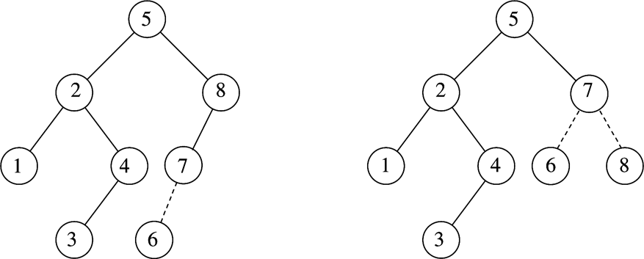
AVL Insertion
Inserting 6
violated
the balance
condition
Rotation 7 -8 restores balance
Insertion can upset the balance
Can be fixed by Rotation

Slide 105
AVL Tree Rotations
Types of rotations
  Left rotation
    Nodes from right subtree move to left subtree
    Root of right subtree becomes root of reconstructed subtree
  Right rotation
    Nodes from left subtree move to right subtree
    Root of left subtree becomes root of reconstructed subtree

Slide 106
AVL Tree Rotations
Right rotation at b

Slide 107
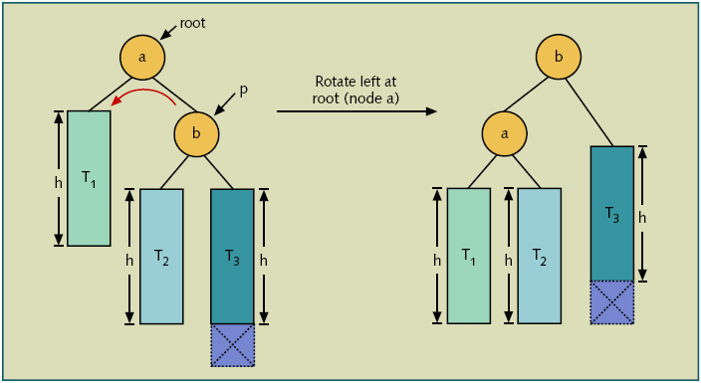
AVL Tree Rotations
Left rotation at a

Slide 108
Each time the tree structure is changed, the balance factors are checked and if an imbalance is recognized, then the tree is restructured.
For insertion there are four cases to be concerned with.
Deletion is a little trickier.

Slide 109
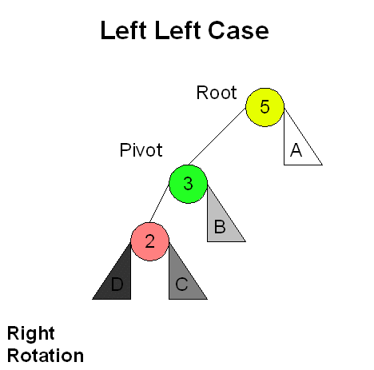
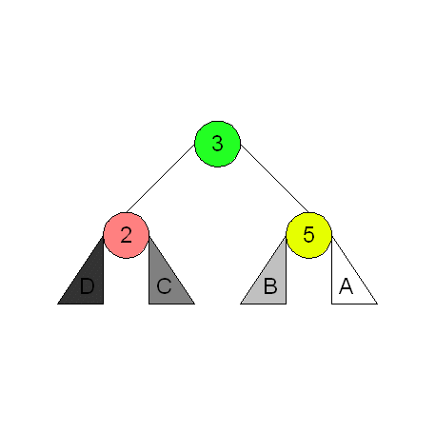

Slide 110
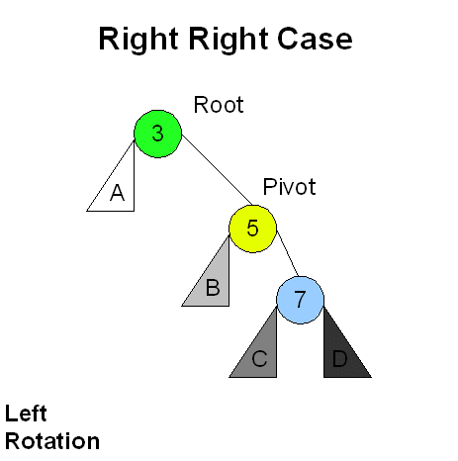
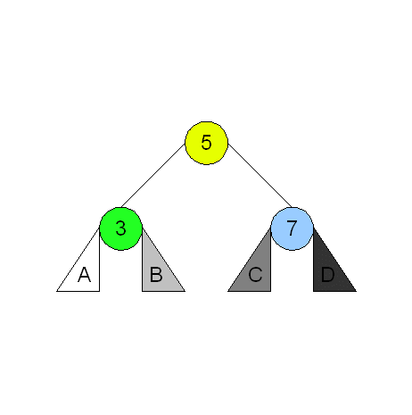

Slide 111
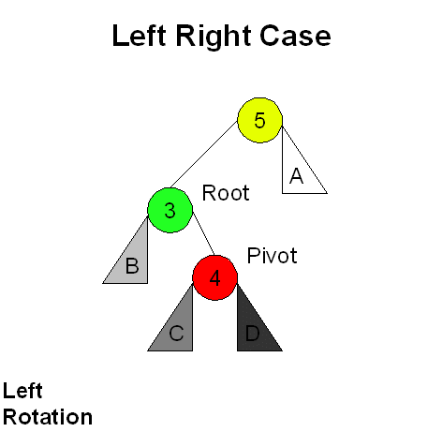
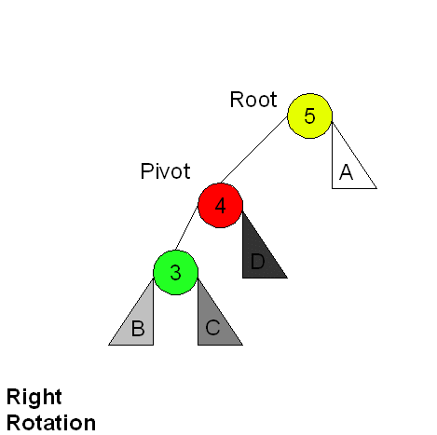
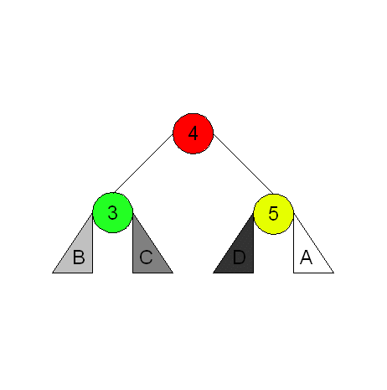

Slide 112




Slide 113
Insertion Example
unbalanced...
T
4
1
44
2
3
x
17
y
62
z
1
2
2
32
50
78
1
1
1
...balanced
48
54
88
T
2
T
T
0
3

Slide 114
Deletion in an AVL Tree
Removal begins as in a binary search tree, which means the node removed will become an empty external node. Its parent, w, may cause an imbalance.
Example:
44
44
17
62
17
62
32
50
78
50
78
48
54
88
48
54
88
before deletion of 32
after deletion

Slide 115
Rebalancing after a Removal
Let z be the first unbalanced node encountered while travelling up the tree from w. Also, let y be the child of z with the larger height, and let x be the child of y with the larger height.
We perform restructure(x) to restore balance at z.
As this restructuring may upset the balance of another node higher in the tree, we must continue checking for balance until the root of T is reached
62
a=z
44
44
78
w
17
62
b=y
17
50
88
50
78
c=x
48
54
48
54
88

Slide 116
Heaps
A heap orders its node, but in a way different from a binary search tree
A complete tree is a heap if
  The value in the root is the smallest of the tree
  Every subtree is also a heap
Equivalently, a complete tree is a heap if
  Node value < child value, for each child of the node

Slide 117
Heap-Order: for every internal node v other than the root, key(v) >= key(parent(v))
A heap (or, a min-heap) is a binary tree with two special properties
  It is almost complete
    All nodes are filled in, except the last level may have some nodes missing toward the right
  The tree fulfills the heap property
    All nodes store values that are at most as large as the values stored in their descendants
Heap property ensures that the smallest element is stored in the root

Slide 118




Slide 119
Height of a Heap
• Theorem: A heap storing n keys has
height O(log n)
• Proof: (we apply the complete binary tree
property)
– Let h be the height of a heap storing n keys
– Since there are 2^{i} keys at depth i = 0, … , h −
2 and at least one key at depth h − 1, we
have n 1 + 2 + 4 +… + 2h−2 + 1
– Thus, n 2h−1 , i.e., h log n + 1

Slide 120


Slide 121

We can use a heap to implement a priority queue
We store a (key, element) item at each internal node
We keep track of the position of the last node
For simplicity, we show only the keys in the pictures

Slide 122

Inserting a New Element in a Heap
Add a vacant slot to the end of the tree

Slide 123
Inserting a New Element in a Heap
Demote the parent of the empty slot if it is larger than the element to be inserted
  Move the parent value into the vacant slot, and move the vacant slot up
  Repeat this demotion as long as the parent of the vacant slot is larger than the element to be inserted

Slide 124

Inserting a New Element in a Heap

Slide 125

Inserting a New Element in a Heap

Slide 126
Inserting a New Element in a Heap
At this point, either the vacant slot is at the root, or the parent of the vacant slot is smaller than the element to be inserted. Insert the element into the vacant slot

Slide 127

Inserting a New Element in a Heap

Slide 128

Removing an Arbitrary Node from a Heap
Extract the root node value

Slide 129
Removing an Arbitrary Node from a Heap
Move the value of the last node of the heap into the root node, and remove the last node. Hep property may be violated for root node (one or both of its children may be smaller).

Slide 130

Removing an Arbitrary Node from a Heap

Slide 131
Removing an Arbitrary Node from a Heap
Promote the smaller child of the root node.
Root node again fulfills the heap property. Repeat process with demoted child.
Continue until demoted child has no smaller children. Heap property is now fulfilled again.
This process is called "fixing the heap".

Slide 132

Removing an Arbitrary Node from a Heap

Slide 133

Removing an Arbitrary Node from a Heap

Slide 134

Storing a Heap in an Array

Slide 135
Implementing a Heap
Recall: a heap is a complete binary tree
  (plus the heap ordering property)
A complete binary tree fits nicely in an array:
  The root is at index 0
  Children of node at index i are at indices 2i+1, 2i+2
2
0
3
0
1
2
3
4
5
5
1
4
2
2
5
4
11
8
7
11
3
5
8
4
7
5

Slide 136
Some Applications of Trees
Data retrieval (search)
Priority queues
Decision systems
Hierarchies
Games
Notes:
“Infinite” recursion eventually overflows the system stack and the program crashes.

Slide 137
Differences of a Heap with a Binary Search Tree
The shape of a heap is very regular
  Binary search trees can have arbitrary shapes
In a heap, the left and right subtrees both store elements that are larger than the root element
  In a binary search tree, smaller elements are stored in the left subtree and larger elements are stored in the right subtree

